Slide 1
Hospital Finder
PIP2001 Capstone Project
Review-0
Batch Number:32
Roll Number | Student Name
20211CSE0124 | Kudala Venkata Sainath Reddy
20211CSE0115 | Bogireddy Sharath Chandra Reddy
20211CSE0118 | Vundela Meghanatha Reddy
20211CSE0518 | Nalamari Keshava Reddy
Under the Supervision of,
Ms.Ayesha Taranum
Assistant Professor
School of Computer Science and Engineering
Presidency University
Name of the Program: B.TECH
Name of the HoD: Dr. Blessed Prince P/Dr. Robin Rohit/Dr.Asif Mohammed H.B
Name of the Program Project Coordinator: Mr. Amarnath J.L & Dr. Jayanthi. K.
Name of the School Project Coordinators: Dr. Sampath A K / Dr. Abdul Khadar A / Mr. Md Ziaur Rahman

Slide 2
Content
Problem Statement
Github Link
Analysis of Problem Statement
Timeline of the Project
References

Slide 3
Problem Statement Number: PSCS211
Organization: CDK Global(India) Pvt Ltd
Category (Hardware / Software / Both) :Software
Problem Description:
In the state of mind that a common person is in during a medical emergency, it becomes difficult to take calculated decisions such as which hospital to rush to. This lapse of decision could mean the difference between life or death for a loved one. Additionally, there are several aspects to consider such as availability of the required medical facilities, medicines, blood group and specialists to provide the patient with a maximum chance of survival in those crucial moments. Our app aims to be the solution, giving the user all the necessary information during a medical emergency taking into account their location and requirements and providing the best-suited hospital in that hour of need.
Difficulty Level: Simple

Slide 4
Github Link
The Github link provided should have public access permission.
Github Link
https://github.com/SAINATH18-hub/CSE-G32-CAPSTONE-PROJECT

Slide 5
Analysis of Problem Statement
Technology Stack Components:
Frontend:
Mobile App: React Native, Flutter, or Android (Kotlin)/iOS (Swift)
Backend:
Server-Side Framework: Node.js (Express), Django, or Flask
Database: MySQL, PostgreSQL, or MongoDB
Api’s :
Google Maps API (for location services)
Hospital information APIs or manually entered data
SMS or email notification services (Twilio, SendGrid)

Slide 6
Analysis of Problem Statement (contd...)
Software Requirements:
Android Studio
HTML & HTML5
CSS
Google Maps API
Node.js

Slide 7
Analysis of Problem Statement (contd...)
Location-Based Challenges
Complexity of Hospital Selection
Medical Facilities
Medicines
Blood Group
Specialists
Storage and Transmission
Performance Overhead
Feature Preservation

Slide 8
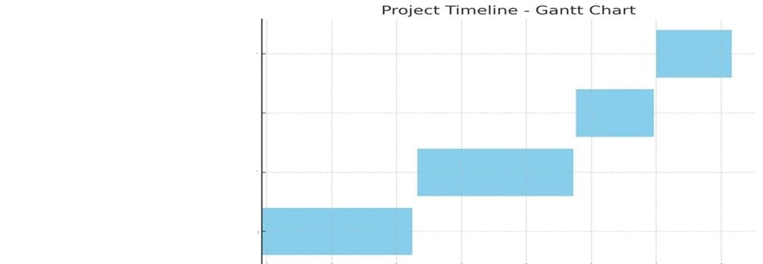
Timeline of the Project (Gantt Chart)
Final Report and Presentation
Testing and Refinement
Development of App(Frontend&Backend)
Research and Analysis

Slide 9
Timeline of the Project (Gantt Chart)
Research and Analysis: September 2024 -October 2024
Development of App(Frontend&Backend): October 2024 - November 2024
Testing and Refinement: November 2024
Final Report and Presentation: December 2024
( it will take around 3 to 4 months)

Slide 10
References (IEEE Paper format)
1.Agarwal, S., & LeFevre, A. E. (2017). Finding healthcare at your fingertips: A case study of apps addressing healthcare needs in India. In Proceedings of the Ninth International Conference on Information and Communication Technologies and Development (ICTD).
2. Hossain, M. S., & Ahmed, K. (2019). Telemedicine system using Hospital Finder app. In 2019 3rd International Conference on Electrical, Computer & Telecommunication Engineering (ICECTE).
3. Mehta, N., Pandit, A., & Shukla, S. (2016). Hospital Finder mobile applications: a systematic review. International Journal of Pharmacy & Technology, 8(3), 16065-16073.
4. National Institute of Standards and Technology (NIST). (2020). Digital Identity Guidelines: Authentication and Lifecycle Management. Retrieved from https://nvlpubs.nist.gov/nistpubs/SpecialPublications/NIST.SP.800-63b.pdf
5. Llorens-Montes, F. J., Ruiz-Moreno, A., & del Barrio-García, S. (2015). Hospital Finder applications and service quality: Influencing patient loyalty and recommendation. Computers in Human Behavior, 48, 542-549
https://www.indeed.com/career-advice/career-development/how-to-cite-a-research-paper

Slide 11


